Slide 1

Informatica data maintenance
System for colleges
SAKTHIVEL.C (151033806)
III Year / VI Semester
DEPARTMENT OF COMPUTER SCIENCE AND ENGINEERING
Mahendra Engineering College(Autonomous), Namakkal Dt.
MINI PROJECT
Under the Guidance of
Mrs.K.RAJESWARI M.Tech.,
(Assistant Professor),
Ass.Professor, Department of Computer Science and Engineering
Mahendra Engineering College(Autonomous), Namakkal Dt.

Slide 2
ABSTRACT
To develop a Desktop Application that allows to do all services at single window in a easiest and efficient manner. In today’s scenario in almost all colleges, they maintain separate systems and separate databases for storing different data like Attendance, Results, for each semester and everything. But it is very difficult to maintain all those databases at a single window. We can’t handle them all at same time. Analysis of all databases needs handling of all databases at a time. But this is uncertain using traditional RDBMS systems. We can’t scale the RDBMS database to large organizations.
In this project, we provide solution for all those drawbacks of using traditional RDBMS system. We’ve created a single Java standalone desktop application that gives way to handle all the databases at same time. We’ve used MongoDB as backend that enables scalability of the application according to rise of data. Java Swing is used as the Frontend, and that gives an elegant look to the application. In addition to this, Hadoop MapReduce Framework is used to speed up the processing of data.

Slide 3
SYSTEM REQUIREMENT
The System Requirements state the minimum requirements needed to deploy and run this software.
The hardware requirements may serve as the basic for a contract for the implementation of the system and should therefore be a complete and consistent specification of the whole design.
The software requirements document is the specification of the system. It should include both definition and specification requirements. It is a set of what the system should do rather than how it should do it.
The software requirements provide a basis for creating the software requirements specification. It is useful in estimation cost, planning, team activities, performance tasks and tracking the teams and tracking the team’s progress.

Slide 4
HARDWARE RQUIREMENTS
Processor : Intel Core i7
Target Device : Windows, Linux Systems
Primary Memory : 16 GB
Secondary Memory : 500GB
Input Device : Mouse & Keyboard
Output Device : VGA Monitor

Slide 5
SOFTWARE REQUIREMENT
Operating System : Windows 10
Front End : Java Swing, AWT
Back End : Java, MongoDB, Hadoop MapReduce
Development Tool : Eclipse IDE
Emulator : Java Virtual Machine

Slide 6
HADOOP
Hadoop is an open-source framework that allows to store and process big data in a distributed environment across clusters of computers using simple programming models.
It is designed to scale up from single servers to thousands of machines, each offering local computation and storage.

Slide 7
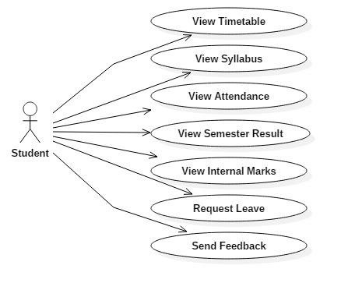
SYSTEM DESIGN

Slide 8
MODULE
1.GUI Module
2.Authenticatio Module
3.Result Analysis Module
4.Feedback Module
5.Syllabus Module
6.Result Display Module
7.Attendance Module

Slide 9
GUI MODULE
Graphical User Interface is designed using Java Swing framework. Swing API is a set of extensible GUI Components to ease the developer's life to create JAVA based Front End/GUI Applications. It is built on top of AWT API and acts as a replacement of AWT API, since it has almost every control corresponding to AWT controls.
Features of Swing:
Light Weight
Rich Controls
Highly Customizable
Pluggable look-and-feel

Slide 10
AUTHENTICATION MODULE
All the users are authenticated to enter into the software. Admin provides username and password for all users. The credentials are stored in the MongoDB database and while login, the username and password is verified using business logic. If they are same as the data stored in database, then they’ll be allowed to use the software.
MongoDB stores the username and passwords in a separate document which is highly secured.

Slide 11
RESULT ANALYSIS MODULE
In this module, the superiors can able to analyse the students result for a particular amount of periods.
For example, we can analyse the pass/fail percentage of students department-wise. The toppers can be easily filtered out using their CGPA.
It needs a large amount of data to be searched and filtered. It takes much time if we use SQL databases.
But, in our case I used a NoSQL database which supports MapReduce, hence it retrieves filtered data very sooner than SQL databases. It supports easy scalability than SQL. We use Apache Hadoop’s MapReduce framework for processing of this large data.

Slide 12
FEEDBACK MODULE
This module allows students and staffs to communicate in an easiest way. Students can feedback about classes and teachings after Authentication process.
They can enter their Name and Register number along with a feedback and submit the form. It will stored in the database along with date and time.
Whenever the Superiors requested to view the feedbacks, it will be displayed along with Students name, date and time of submission.
It will be very useful for further improvements of the teaching and providing a formal-interaction between staffs and students.

Slide 13
SYLLABUS MODULE
When the student wants to view the Syllabus of any subject, he can go to the Syllabus window.
To display the PDF file within the system, I used an Adobe Acrobat library acrobat.jar.
It produces a new Frame and there we can view the Syllabus. It provides an easy way to Zoom in, Zoom out and Go To options.

Slide 14
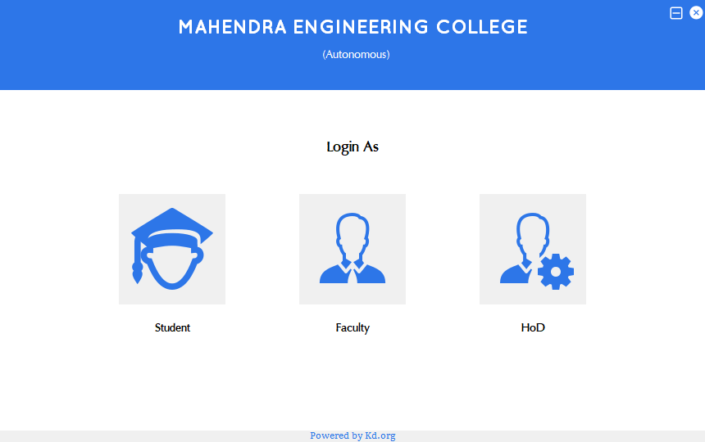
SCREEN SHOTS

Slide 15
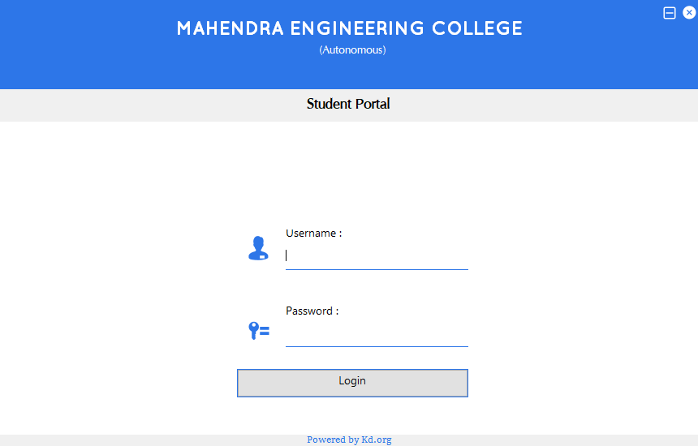

Slide 16
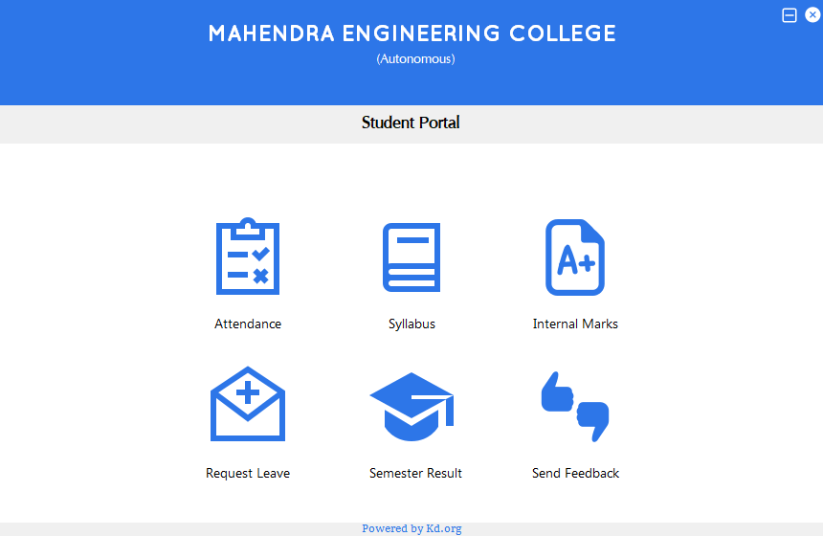

Slide 17
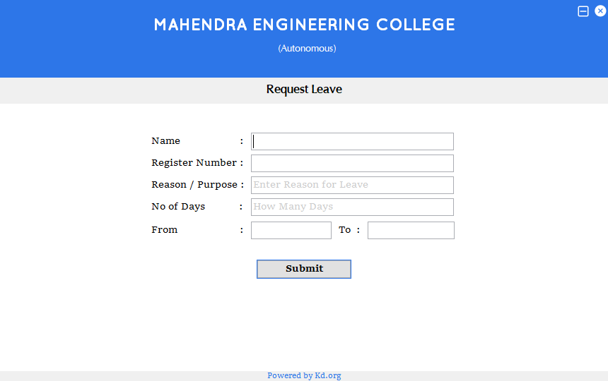

Slide 18
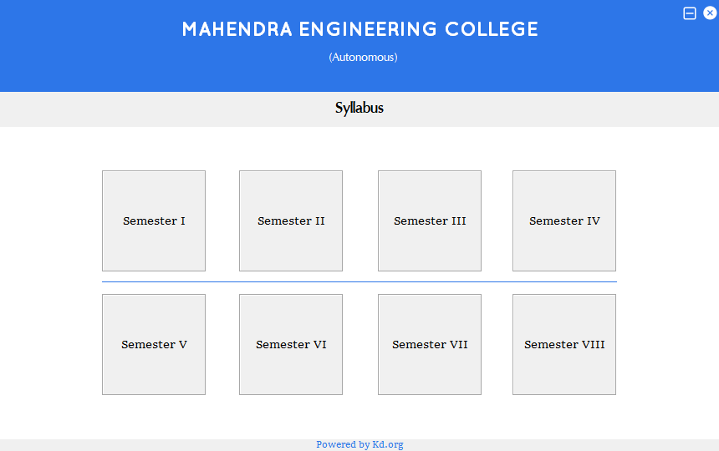

Slide 19
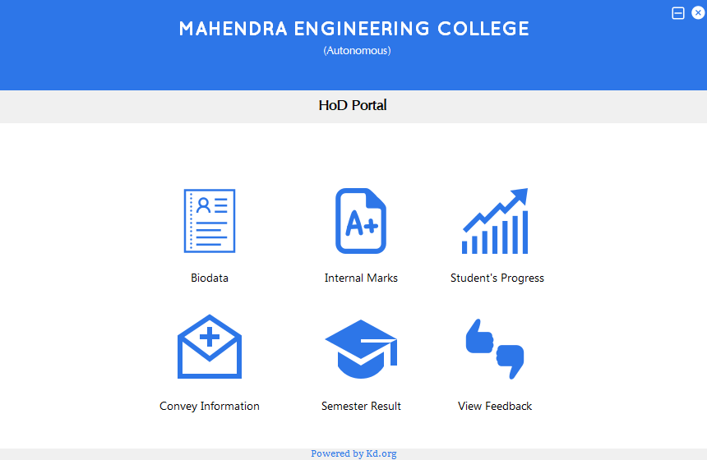

Slide 20
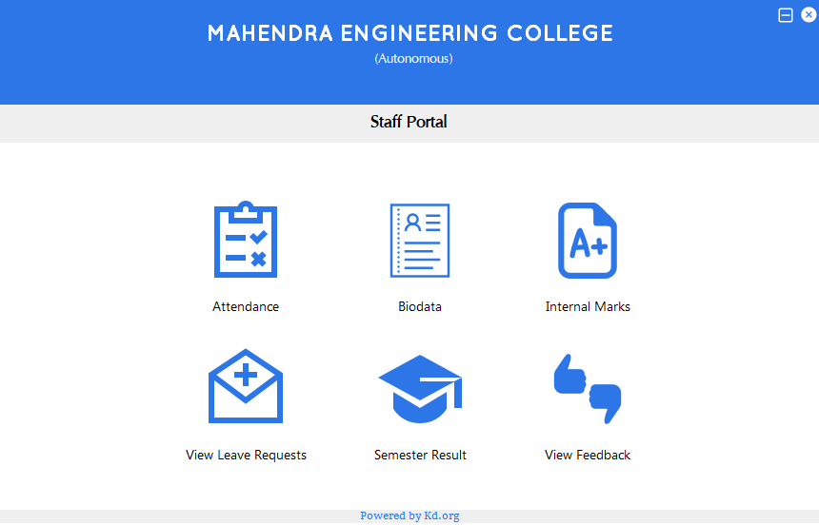

Slide 21
CONCLUSION
At the end of the day, we’ve created a Desktop Application using Java and Map Reduce. This application will make much of the documentation works very easier for staffs and Head Of the Departments. It can be deployed on any kind of operating systems such as Mac OS, Windows OS and Linux OS. As this application has a lighter and elegant UI, users can have a better working experience.

